Slide 1

The Gamma Test
Octobre 2004

Slide 2
Outlines
The Gamma Test:
What is it ?
What can we do with it ?
Some examples

Slide 3
The Gamma Test:
What is it ?
The Gamma Test is an estimator of the modelisation noise
The data set: (x^{i}₁, …, x^{i}_{M}, y^{i})
The Gamma Test
estimates the value
of Var(r)
The model: y^{i} = f(x^{i}) + r
With some hypothesis on f:
∃ A, B
|∇f(x)|<A
|Hf(x)|<B
Notes:
The Gamma Test is a tool which is able to estimate the value of the modelisation noise.
The modelisation noise is the level of “data” which is not explainable by a smooth model (a smooth model is a model with a limited gradient and a limited hessian).
The Gamma Test is really efficient to estimate the noise level and mean of the norm of the gradient of the smooth model.

Slide 4
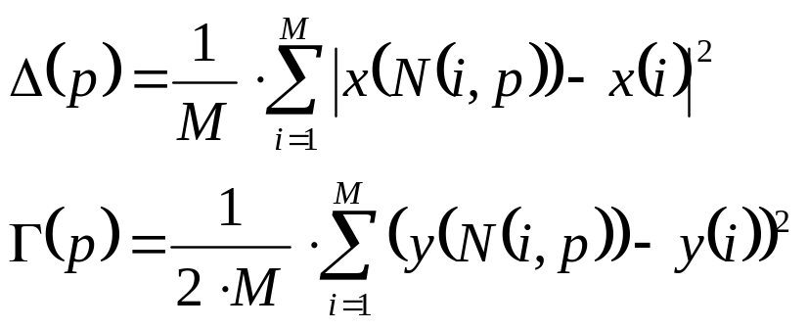


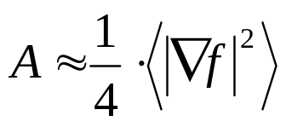
The Gamma Test:
What is it ?
For p in [1, …, n] compute:
Where:
M is the number of points in the data set;
N(i,p) is the pth nearest neighbor of point I (localised using kd-tree;
n is a parameter defined by the user
Next, compute the regression line of these points:
Notes:
To perform an efficient analysis using the gamma test, we must use a KD-tree to store the data set.
The KD-tree allows us to locate efficiently nearest neighbors points of a given point.
Once the Gamma and the Delta have been computed, a linear regression of a small set of points remains to be done. Usually, the Gamma Test is performed on p=20 neighbors.

Slide 5
The Gamma Test:
What can we do with it ?
Model learning:
Using the value of Var(r) to stop the learning before over training
Model sizing:
Using the value of A to pre-determine the size of the model (see A. Pui Man Tsui and Koncar)
Inputs selection:
What are the inputs that minimize the modelisation error
Notes:
The Gamma Test estimates the RMS level of the noise. This level is used to stop the training of the model. Once the model has reached this level of RMS error, a further learning of the data set will learn the noisy part of the data set.
This has not been proved but it makes sense to stop the learning of the model using this level of noise.
For model sizing, the Gamma Test estimate of the mean norm of the gradient is used with a “special” neural network construction method. Pui Man Tsui defines the minimum number of neurons to model a “gaussian” and then, he computes analytically the value of the mean norm of the gradient of this multidimensional gaussian and correlates this value to the value given by the Gamma Test.
For inputs selection, we use a data set and, then, we compute a binary mask. With this mask, a 0 corresponds to a masked column of data and a 1 corresponds to a non masked column of data. We generate all the possible binary mask and, for each mask, we compute the var(r) estimate of the corresponding data set. The selected inputs are the one which minimize the value of the var(r) estimate.
To improve the rapidity of input selection, we can use a “greedy” version of this kind of input search.

Slide 6


The Gamma Test:
What can we do with it ?
The Scatter Plot:
Plot
in the plane for each i and p
The M-test:
Plot the value of A and B
For various values of p
A
Studying the
stability of the
estimation
w.r.t p
Γ
Studying the
proximities
relationship
p
10
20
30
40
50
60
δ
Notes:
With the Gamma Test, we can use two graphs to sum-up the informations given by the Gamma Test:
The scatter plot:
In the scatter plot, we represent each “atomic” Gamma and Delta values. Small values of Delta represents neighbor points. Big values of Delta represent farther neighbors.
If the points are close one to the other, a small variation of Delta (which corresponds to close values of xi) should correspond to small variation of Gamma (which corresponds to close values of yi). If we have big variation of yi, then, we can conclude that yi measures are covered with noises.
The M-test:
The M-test is used to see if we have reached a stable estimate of the var(r) value. To perform the M-test, we just perform the Gamma test for p=1, 2, .., 10, .., 30, etc and plot the result in a graph. Once the var(r) value has reached a stable value, we have a good estimate of var(r).

Slide 7
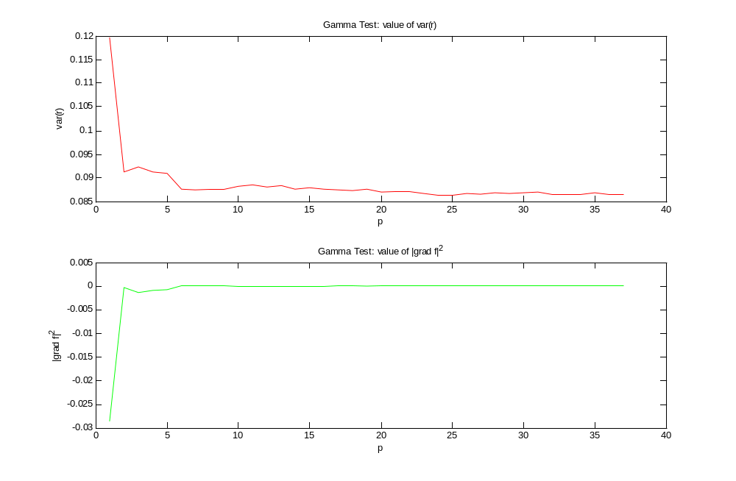
The Gamma Test:
What can we do with it ?

Slide 8
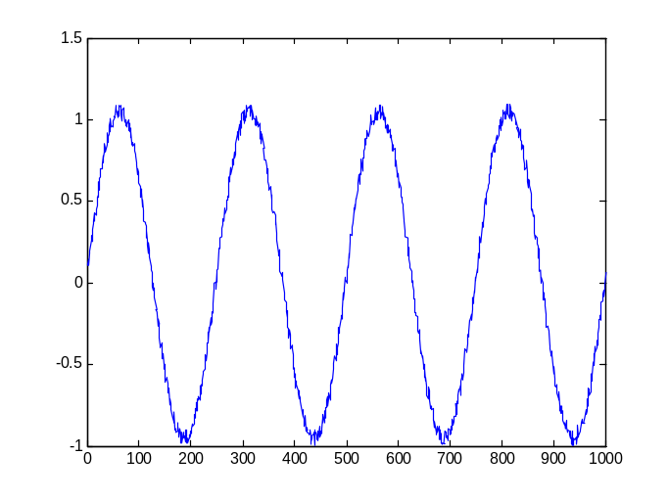
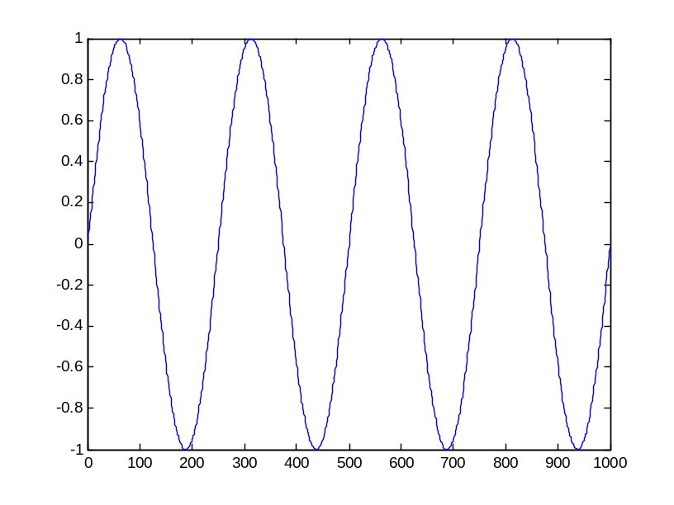
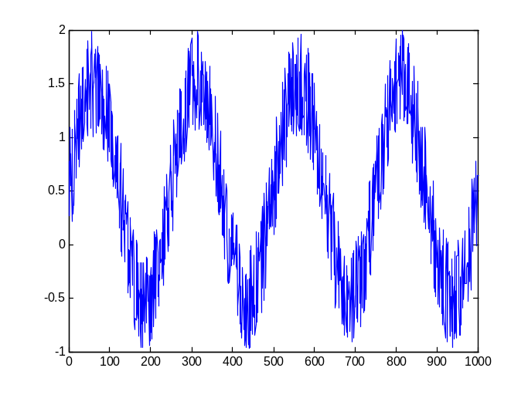
The Gamma Test:
Some examples
Sine wave with noise
Sine wave without noise
0.1*rand(0,1)
rand(0,1)

Slide 9
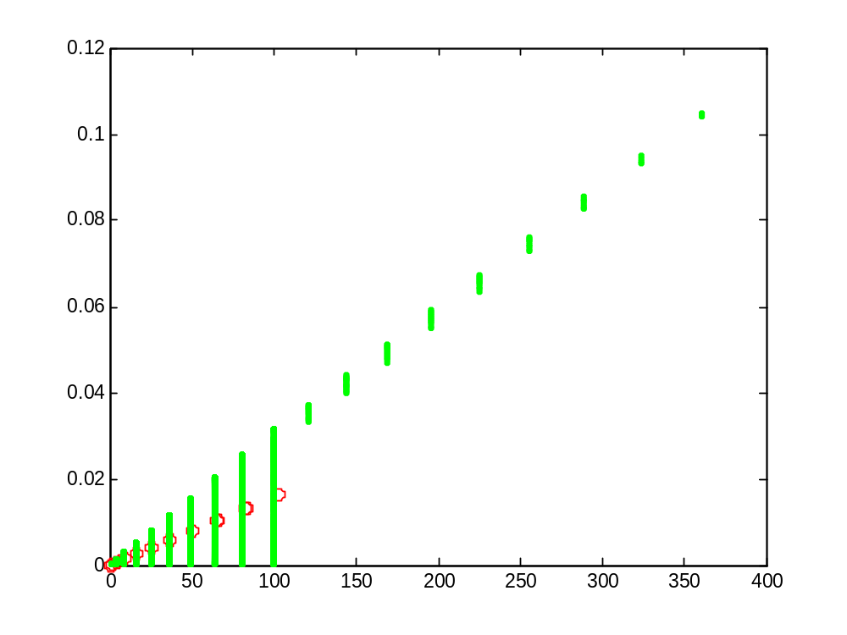
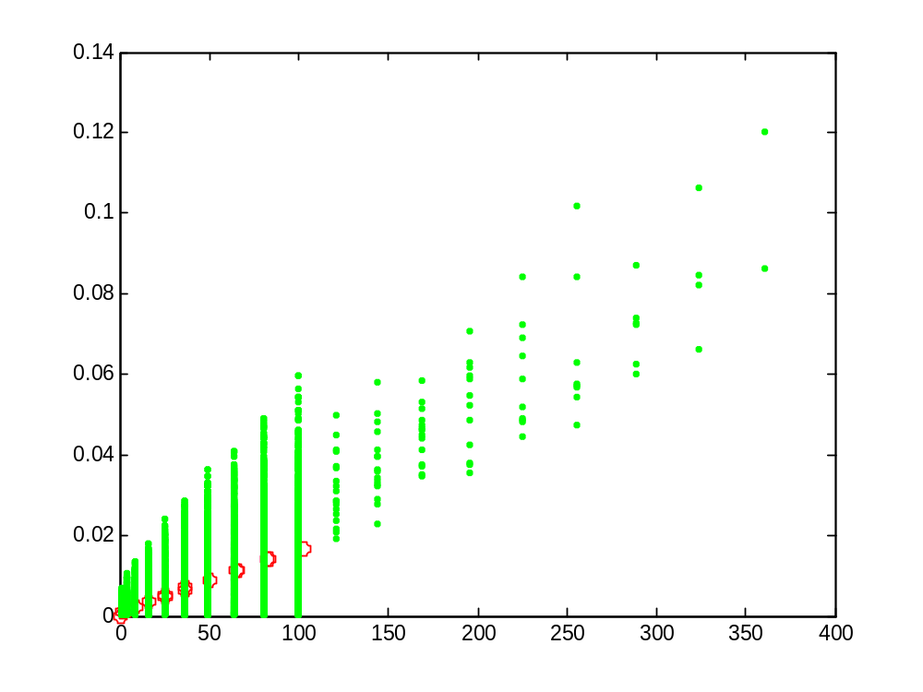
The Gamma Test:
Some examples
Sine wave without noise
Sine wave with noise
0.1*rand(0,1)
Results: Estim 3.95E-6
Value 0.0
A = 0.00015
Results: Estim 0.00083
Value 0.00084
A = 0.00015
Notes:
We can conclude that the estimate of var(r) given by the Gamma Test are accurate and that the estimate of the mean norm of the gradient is also stable and efficient.
Both sets share the same sinus values. The only thing which is different is the noise level.
For the first case, the estimate is quite low (nearly equal to 0).
For the second case, the estimate is in good correspondence to the real one. And the estimate of the mean norm of the gradient is identical for both sets which is normal because the underlying smooth model is equivalent for both sets.

Slide 10
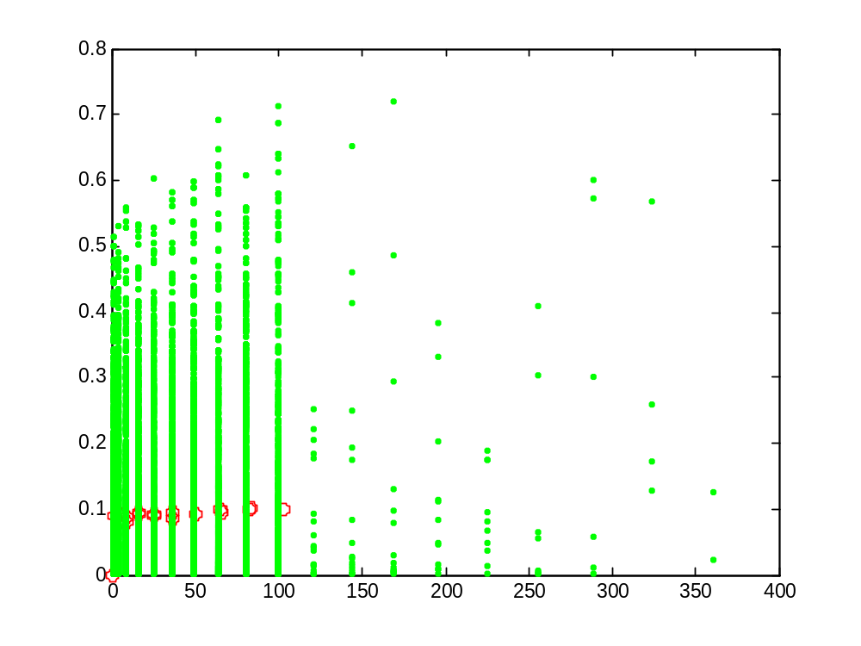
The Gamma Test:
Some examples
Sine wave with noise
rand(0,1)
Results: Estim 0.0086
Value 0.0084
A = 0.00012
Notes:
Here, the noise level is very high. The Gamma Test gives a good estimate of this noise level and the value of the mean norm of the gradient is quite equivalent to the one given for preceding data sets.

